Slide 1
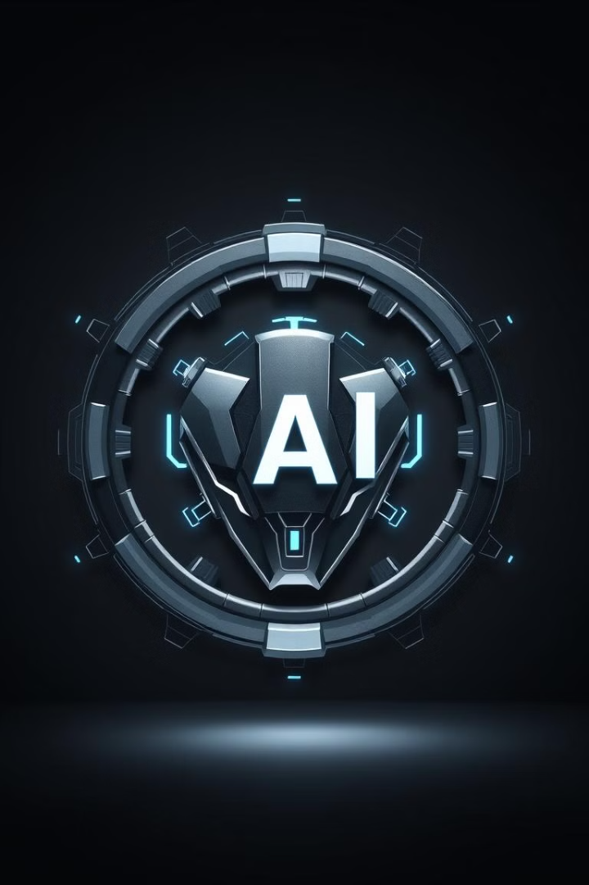
LogoCraft: Crafting Memorable Brand Identities with AI
A Presentation for Innovators and Investors

Slide 2
The Problem: The Challenge of Effective Logo Design
Time-Consuming
Expensive
Limited Options
Traditional logo design can take weeks, even months.
Hiring professional designers is a costly investment for startups.
Businesses often settle for generic logos due to budget constraints.

Slide 3




Our Solution: Introducing LogoCraft - AI-Powered Logo Creation
AI-Driven
Generates unique logo options based on user input.
User-Friendly
Easy-to-use platform for non-designers.
Instant Results
Get logo designs in minutes, not weeks.

Slide 4




Key Features & Benefits
Speed
Affordability
Customization
Logo creation in minutes.
Cost-effective for businesses.
Tailor logos to brand identity.

Slide 5

Target Market & Market Opportunity
1
Startups
Need logos quickly and affordably.
2
Small Businesses
Looking to refresh their branding.
3
Entrepreneurs
Launching new ventures.
4
Large Corporations
Automate the logo creation process.

Slide 6
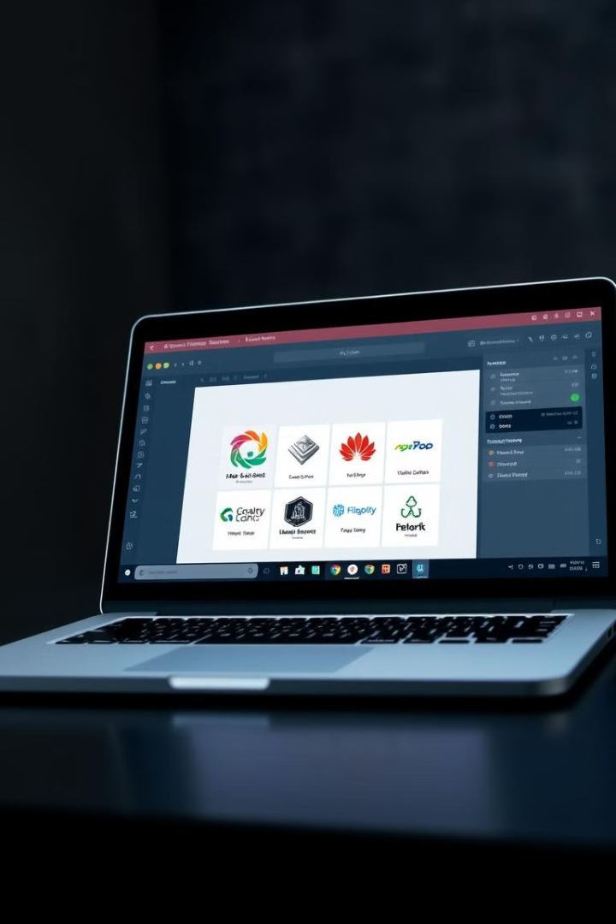
Demo: See LogoCraft in Action
Let's walk through a demo of the LogoCraft platform.
I will show you a live demonstration of the platform's capabilities.

Slide 7
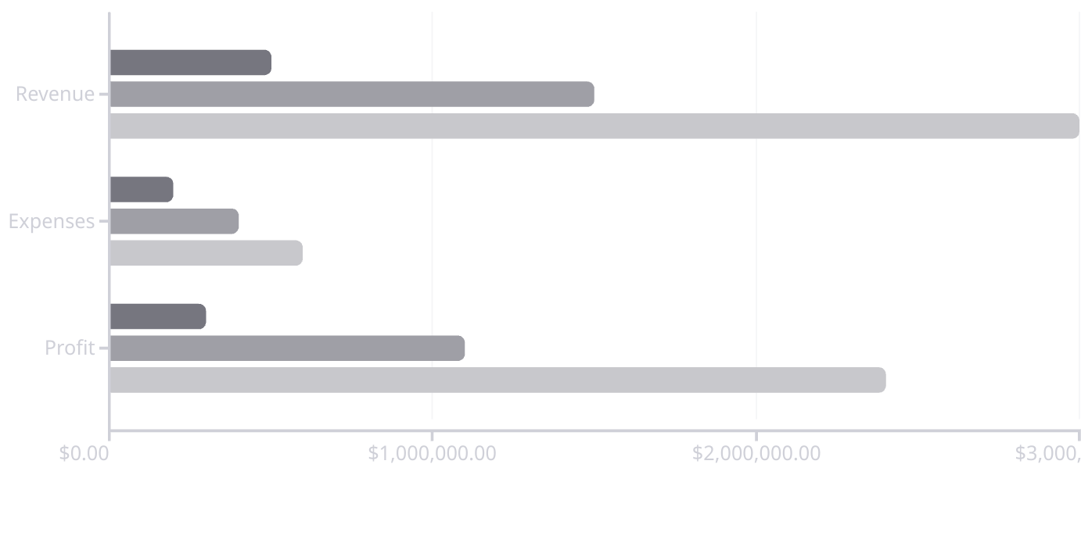
Business Model & Financial Projections
Year 1
Year 2
Year 3
We generate revenue through subscriptions and one-time logo purchases.

Slide 8

Call to Action: Invest in LogoCraft
Invest in the future of logo design with LogoCraft.
Join us and revolutionize how businesses create their brand identities.

